Slide 1


FS Duck Creek – Risk Management
Capgemini Technology Services India Limited
Bhubaneswar | January 2020

Slide 2
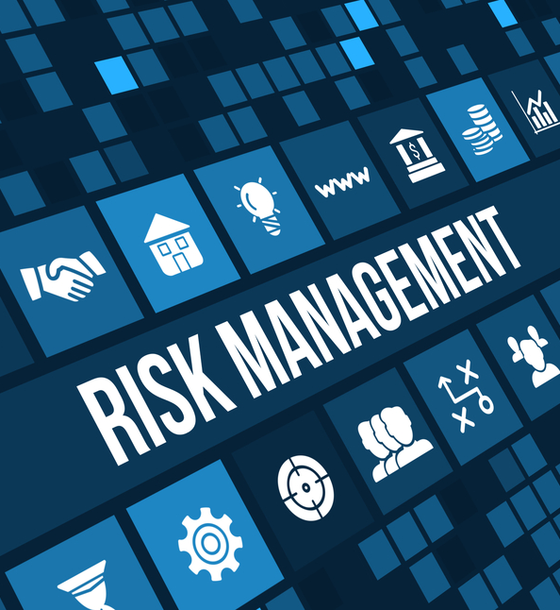
Risk Management
Risk is likelihood or probability that a loss will occur. Alternatively, risk also refers to the subject matter of insurance.
Risk management refers to the practice of identifying potential risks in advance, analyzing them and taking precautionary steps to reduce/curb the risk.

Slide 3


Risk Management – Individuals vs Organizations
usually an informal series of efforts, not a formalized process.
a part of the financial planning process that encompasses capital accumulation, retirement planning etc.
usually a part of a formalized risk management program except for very small organizations.
includes planning, organizing, controlling and leading the resources and activities that an organization needs to protect itself from the adverse effects of accidental losses.

Slide 4

Enterprise-wide Risk Management (ERM)
Traditional risk management focused only on pure risks. Enterprise-wide Risk Management (ERM) includes managing both pure and speculative risks. ERM is a superior risk management approach since some speculative risks result into gains and thus offset some adverse financial consequences of the pure risks.

Slide 5
Risk Management Techniques
Pure risk: Either loss happens or it does not; no possibility of gain
Speculative risk: Possibility of gain exists
Risk Management Techniques
Risk Control
Avoidance
Prevention
Risk Financing
Retention
Transfer
Reduction
Separation
Duplication

Slide 6
Risk Management Techniques
Risk Management Technique | What does it do? | Example
Avoidance | Eliminates the chance of a particular type of loss by either disposing of an existing loss exposure or by not assuming a new exposure. | A family decides not to travel by air to avoid the loss exposure associated with air travel.
Prevention | Lowers loss frequency. | A business installs bars on windows & deadbolts on doors to prevent burglaries.
Reduction | Lowers loss severity. | A business installs a sprinkler system to reduce the amount of fire damages.
Separation | Isolates loss exposure from one another to minimize the adverse effect of a single loss. | An organization stores its inventory in different warehouses.
Duplication | Uses back ups, spares or copies of critical information, property or capabilities and keeps them in reserve. | An organization backs up its database periodically.

Slide 7
Risk Management Techniques
Risk Management Technique | What does it do? | Example
Retention or Assumption | Retains all or part of a loss exposure which means that losses must be paid for with available funds or other assets. Can be intentional and unintentional. | A business decides not to purchase collision coverage for its fleet of vehicles & sets aside its own funds to pay for possible collision losses.
Transfer | Non-insurance Transfer: Transfers potential financial consequences of a loss exposure from one party to another party who is not an insurer. Insurance Transfer: Transfers potential financial consequences of a loss exposure from one party to another party who is an insurer. | In a lease, a landlord transfers the liability exposures of a rented building/apartment to the tenant using a ‘Hold Harmless Agreement’. A family purchases Auto policy from an insurer. An insurer procures reinsurance.

Slide 8
Hazards
Hazard is a condition that increases the frequency or severity of loss.
Physical Hazard - A tangible characteristic of property, persons, or operations that increases the frequency and/or severity of loss.
Moral Hazard - A condition that increases the likelihood that a person will intentionally cause or exaggerate a loss.
Morale or Attitudinal Hazard - A condition of carelessness or indifference that increases the frequency and/or severity of loss.
Legal Hazard - A condition of the legal environment that increases loss frequency or severity.

Slide 9
Risk Management Framework (RMF)
1: Identifying loss exposures
3: Examining feasibility of risk Mgmt. techniques
4: Selecting the appropriate risk Mgmt. techniques
5: Implementing selected risk Mgmt. techniques
6: Monitoring results and revising the risk Mgmt. program
2: Analyzing loss exposures
Who/What is/are at risk?
Continuous evaluation and adjustment (if needed) of the selected risk management approach. Ex – increase/decrease policy limit, purchase new coverage etc.
What are the implications (financial and non-financial) of risk?
Which risk management approach or approaches are suitable to manage the risk(s)?
Implementing the selected risk management approach (or approaches). Ex – purchase a policy, setting up a contingency fund etc.
Finalizing the risk management approach (or a combination of approaches) to be used.

Slide 10
Risk Management Framework (RMF)
Steps in RMF | Key Activities
1. Identifying Loss Exposures | Physical Inspection Loss Exposure Surveys Loss History Analysis
2. Analyzing Loss Exposures | Analyzing loss frequency Analyzing loss severity
3. Examining feasibility of risk management techniques | Assessing feasibility of deploying Risk Control and/or Risk Financing measures
4. Selecting the appropriate risk management techniques | Ensure compliance with financial criteria mandated by rules/regulations.
5. Implementing selected risk management techniques | Deciding who should be responsible Communicate the risk management information to stakeholders Allocate costs of risk management program
6. Monitoring results and revising the risk management program | Periodic evaluation and adjustments

Slide 11
THANK YOU!

